Slide 1
CG Wealth
Introducing the new Client Access Portal

Slide 2
Client Access Portal Update
Modernized!
All the comprehensive information about your account that you are familiar with, now with a fresh digital experience and a modern look and feel.
Easy navigation with left side menu.
A clear snapshot of your total portfolio value with balances updated throughout the day.
Change since last market close for your portfolio accounts updated throughout the day.
  New!
  A summary of your registered accounts is now on the overview page. With a “Details” button to see more information.
  Recommend your advisor to a friend with the Share Contact link.
  Set up account nicknames to easily identify your accounts.
View Documents, Holdings and Activity for your portfolio or any group of accounts using the new multiselect accounts drop-down menu.
Customize your view of holdings by selecting which fields to display; view saved at each logout.
Documents now open in a new browser tab to preview before download or print.
Simplify tax time with a one-click download of all tax documents for the current filing year.

Slide 3
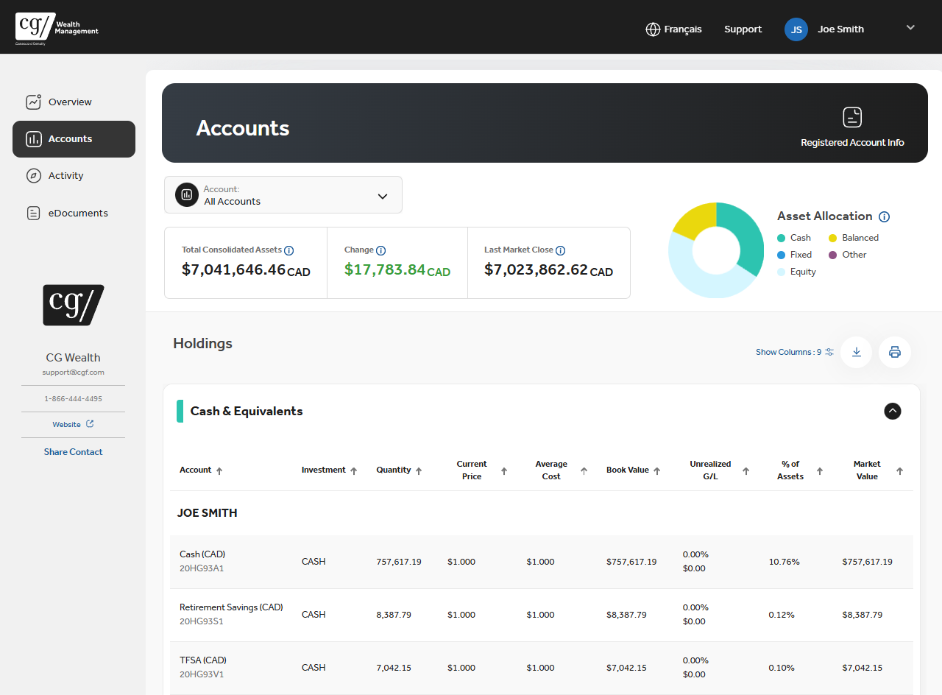

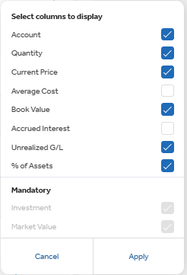
New on the Accounts Page
Find a quick link to the Registered Account Details page
Customize your view by choosing the columns you want to see.
Your column choices are saved when you logout.
Account Nicknames setup in Account Settings appear throughout the portal

Slide 4

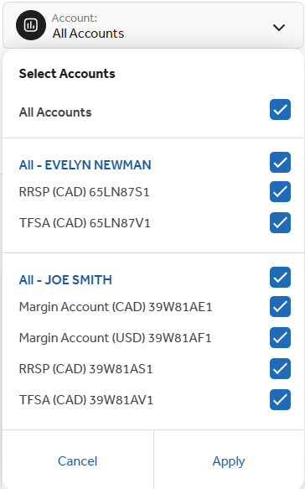
Flexible Multiselect Accounts Drop Down Throughout the Portal
The Accounts drop down now lets you choose any group of accounts.
You can view
Documents
Account Holdings
Activity
for your whole portfolio, for a single account or any group of accounts using the new multiselect accounts drop down

Slide 5
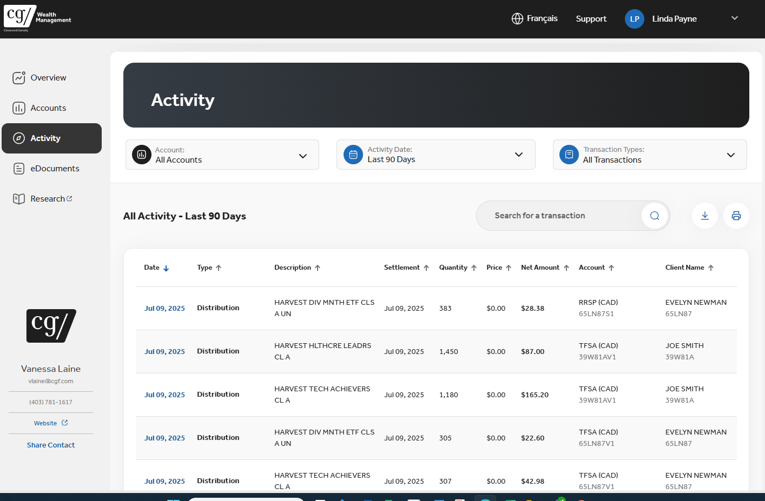
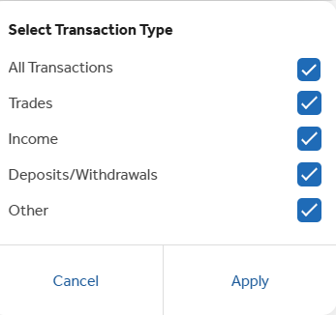
Activity
Find all your activity from account inception on the new Activity Page.
Looking for something specific?
Filter by date range
Search the Description and Type columns with a keyword
Easy to use simplified transaction type search
to sort data by any column click ↑

Slide 6
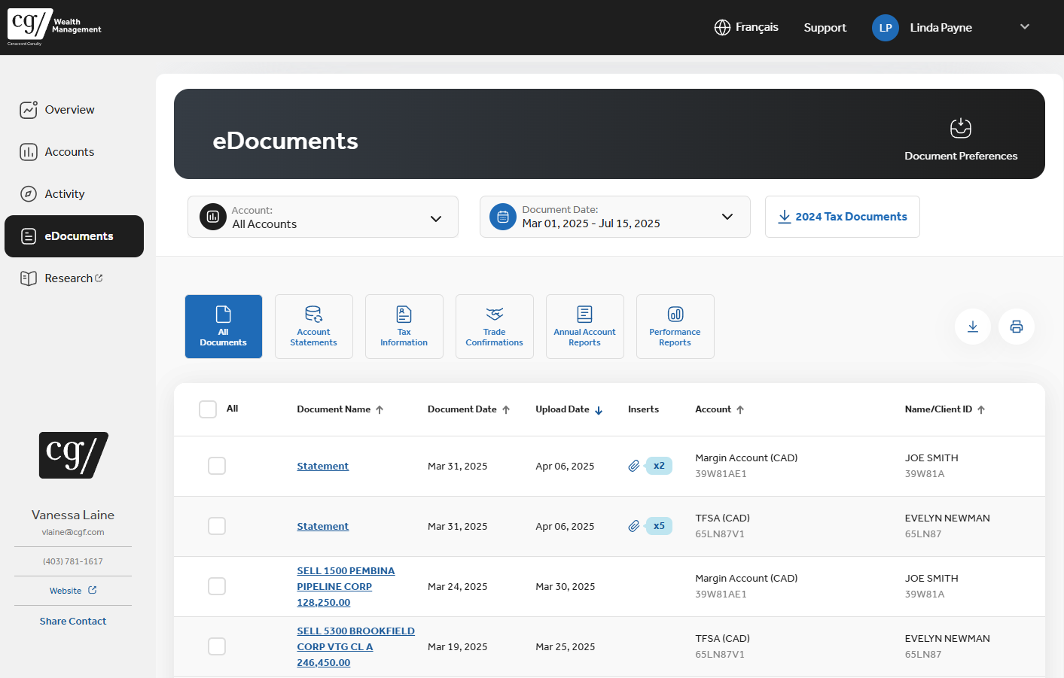

eDocuments Improved
Accounts and Date filters are easy to use and consistent across the portal
Use the new buttons to display documents by type
Documents now open in a new browser tab to preview then download or print
Multiselect to download PDF files organized by Client ID folders in a Zip file

Slide 7
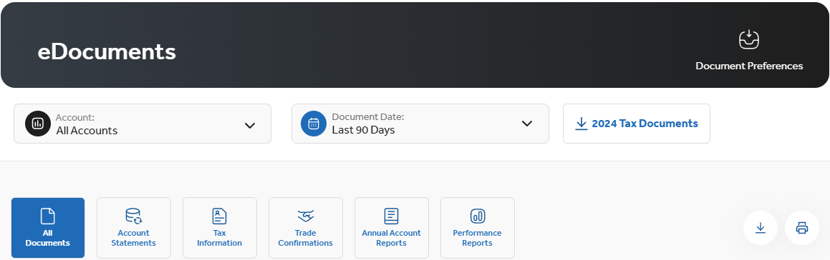
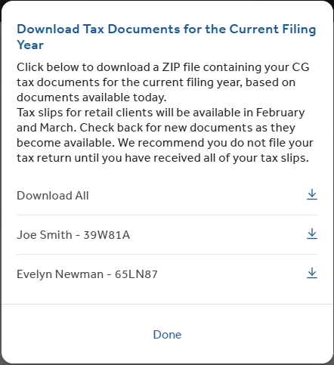
Simplifying Tax Time
No need to filter by date range or document type. Find everything you need at tax time with one click!

